Slide 1
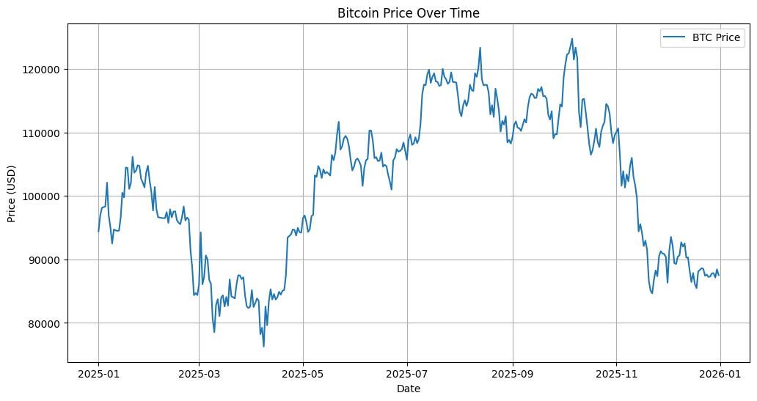
EDAB 6808
Lead–Lag Relationships Between
Bitcoin and Internet Attention
Core finding: internet attention helps explain market participation more than price direction.
Prepared by: Lwazi Nhlapo & Reatile Seekoei
Notes:
Open with the study focus: the project tests whether Google Trends search attention leads, lags, or predicts Bitcoin market variables. Emphasize the main message: attention is more useful for understanding participation and volume than for predicting price direction.

Slide 2
Research problem and hypotheses
Framing
Research question
Google Trends attention
Timing
Does Google Trends internet attention lead or lag Bitcoin market activity, and does it add predictive information for returns, trading volume, and volatility?
Tested with cross-correlation
Lead / lag
timing
Prediction
Tested with Granger
H₀
H₁
Attention does not lead, lag, or predict Bitcoin market variables.
Attention contains useful lead–lag or predictive information.
Bitcoin returns
volume
volatility
Usefulness
Tested with RF + GARCH
Hypotheses tested across four dimensions:
• Lead–lag timing (Cross-correlation)
• Predictive causality (Granger)
• Forecasting performance (Random Forest)
• Volatility explanation (GARCH)
Interpretation principle: Granger causality is predictive causality, not proof of economic causation.
EDAB 6808 : Assignment 1
2/12
Notes:
State the research question clearly. Explain that the null hypothesis means no useful lead-lag or predictive relationship, while the alternative means Google search attention contains useful timing or predictive information.

Slide 3
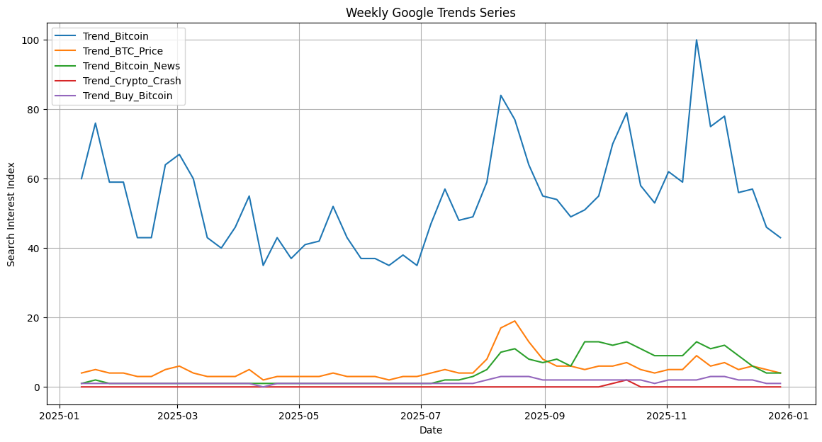
Data sources and variable construction
Data
Daily BTC-USD data were aggregated to match weekly Google Trends frequency.
Yahoo Finance
Google Trends
Weekly alignment
Model-ready data
BTC-USD: price, returns, volume
5 search-intensity keywords
Sunday endpoint; inner join
51 weekly observations; no missing values
Variable group
Constructed variable
Reason
Market level
Weekly closing price
Identifies market regimes
Returns
Simple & log returns
Captures weekly price movement
Activity
Weekly total volume
Measures participation / intensity
Attention
5 weekly search indices
Proxy for internet attention
Weekly Google Trends series
EDAB 6808 : Assignment 1
3/12
Notes:
Explain that Google Trends is weekly, so Bitcoin variables were aggregated to weekly frequency. The merged dataset contains 51 weekly observations with no missing values after alignment.

Slide 4
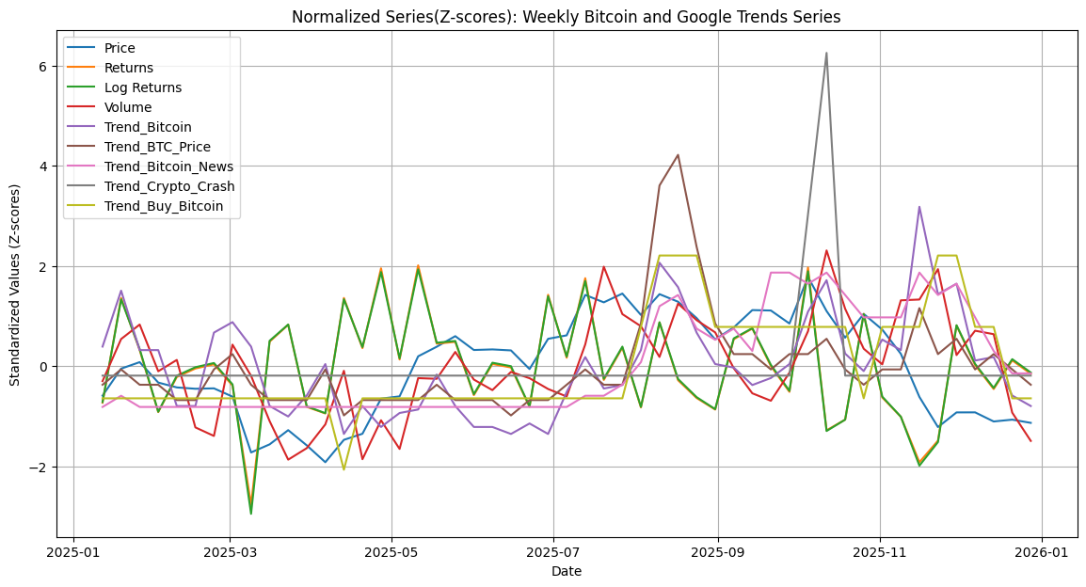
Google Trends keywords capture different investor behaviours
Keyword rationale
The search terms were selected to represent broad attention, price monitoring, news consumption, fear, and purchase intent.
Keyword
Behaviour captured
Use in interpretation
Bitcoin
General public attention
Broad market engagement
BTC Price
Price-checking / monitoring
Short-run market tracking
Bitcoin News
Information search
News-driven attention
Crypto Crash
Fear / uncertainty
Stress-period attention
Normalised market and attention series
Buy Bitcoin
Purchase intent
Demand-side interest
Takeaway: attention indicators are behavioural signals, not direct sentiment scores.
EDAB 6808 : Assignment 1
4/12
Notes:
Clarify why each keyword matters. Bitcoin is general attention, BTC Price reflects monitoring, Bitcoin News reflects information seeking, Crypto Crash reflects stress, and Buy Bitcoin reflects purchase intention.

Slide 5
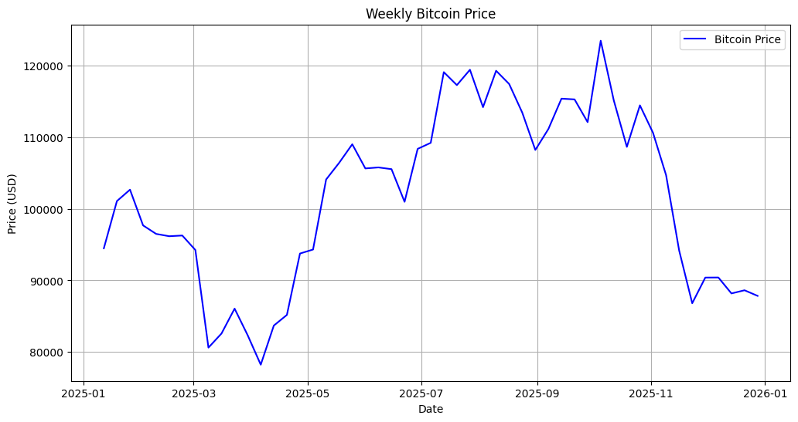
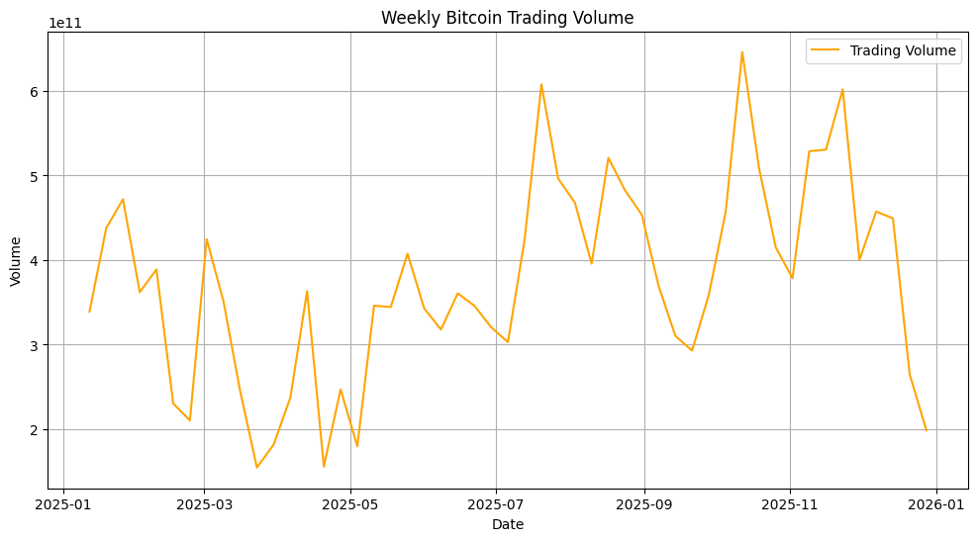
Exploratory analysis: clear Bitcoin market regimes in 2025
EDA
Visual interpretation
Price declined early in the year, recovered strongly mid-year, then corrected late-year.
Returns were volatile and centred around zero, consistent with noisy short-run price movements.
Volume rose during higher-activity and stress periods, especially mid-to-late year.
Search attention often rose with, or after, visible market movements.
Weekly Bitcoin price
51
0
Search
usable merged weeks
missing values after merge
main behavioural proxy
Implication: attention appears stronger as a participation indicator than as a direct price-direction signal.
Weekly trading volume
EDAB 6808 : Assignment 1
5/12
Notes:
Discuss the visual patterns. The market has distinct regimes, but attention does not consistently move before returns. Volume spikes are more visually linked to attention.

Slide 6
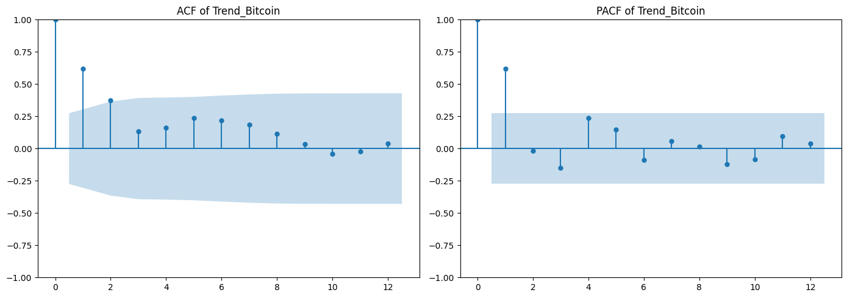
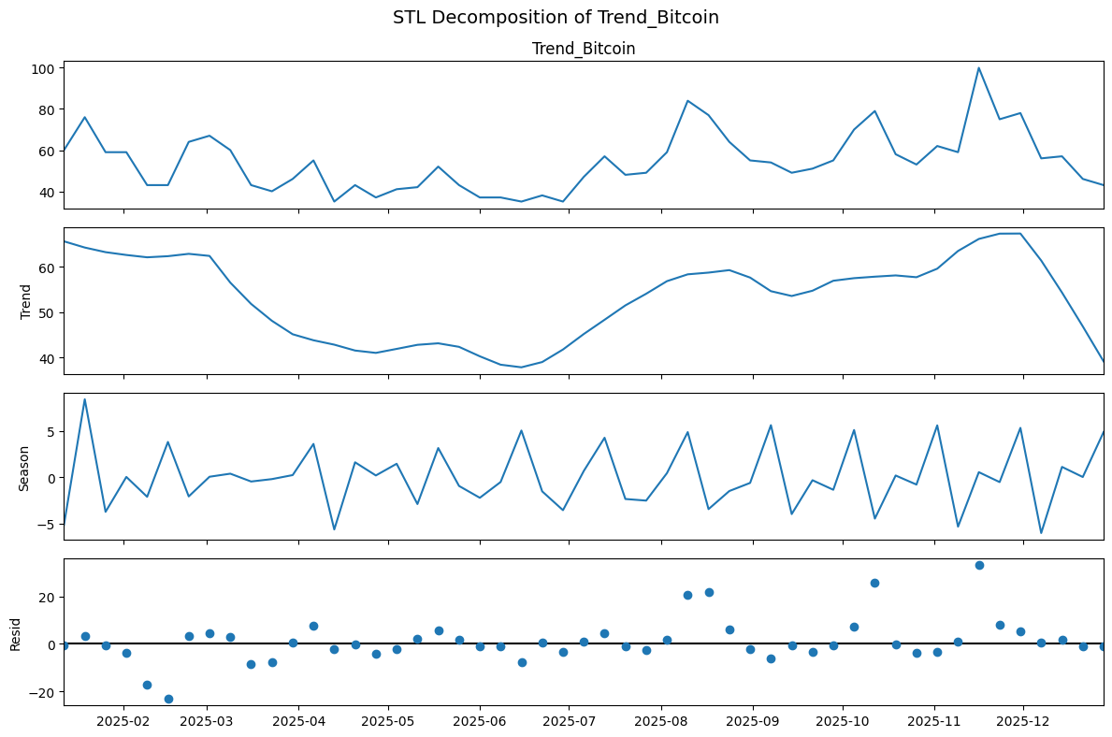
Pre-modelling diagnostics: stationarity and lag structure
Diagnostics
Diagnostic
Purpose
Key result
ADF
Avoid spurious time-series inference
Returns, log returns, Trend_Bitcoin, Trend_BTC_Price and Trend_Crypto_Crash stationary in levels
Differencing
Stabilise non-stationary series
Price, volume and selected trend terms transformed before formal tests
ACF / PACF
Identify persistence and lag memory
Returns weakly autocorrelated; attention variables show short-run memory
ACF/PACF: Trend_Bitcoin
STL
Separate trend, seasonal and irregular components
Attention aligns with cycles but often reacts to shocks
Modelling decision:
Only stationary series were used in formal lead–lag and causality tests to avoid spurious results
Treat Bitcoin News conservatively because stationarity evidence was conflicting.
STL decomposition: Trend_Bitcoin
EDAB 6808 : Assignment 1
6/12
Notes:
Explain why diagnostics were needed before lead-lag analysis. The main point is that returns were stationary, attention variables had some persistence, and non-stationary variables were transformed or treated conservatively.

Slide 7
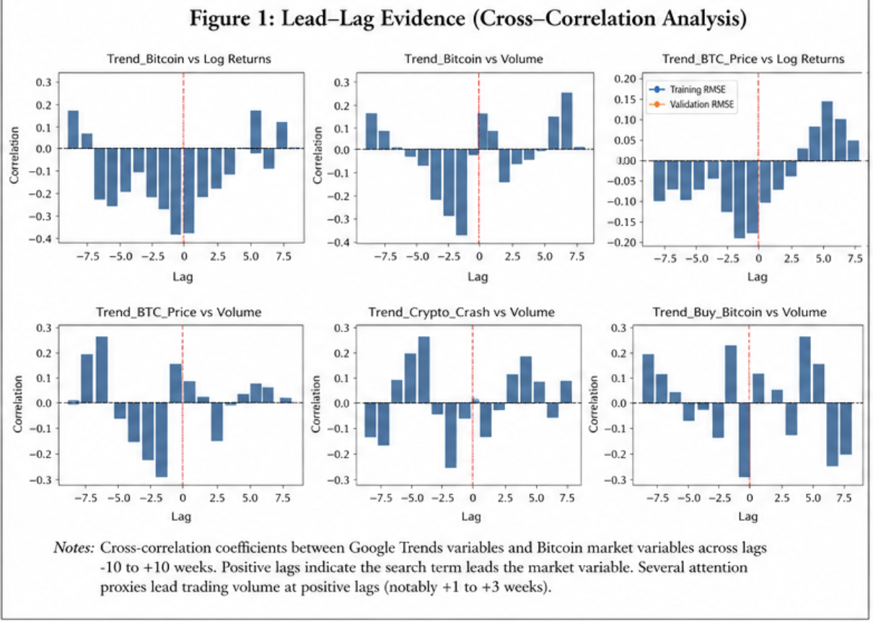
Cross-correlation maps the timing of attention effects
Lead–lag
Best-lag evidence
Trend Variable | Market Variable | Best Lag | p-value at Best Lag | Significant at 5% | Interpretation
Trend_Bitcoin | Log Returns | -1 | 0.010546 | Yes | leads returns by 1 week
Trend_Bitcoin | Volume | -2 | 0.001064 | Yes | leads trading volume by ~2 weeks
Trend_BTC_Price | Log Returns | -2 | 0.213439 | No | limited predictive usefulness.
Trend_BTC_Price | Volume | -2 | 0.092172 | No | limited predictive usefulness.
Trend_Crypto_Crash | Log Returns | -6 | 0.026623 | Yes | lead returns over longer horizons
Trend_Crypto_Crash | Volume | 0 | 0.028036 | Yes | immediate market reactions.
Trend_Buy_Bitcoin | Log Returns | 4 | 0.062932 | No | limited predictive usefulness.
Trend_Buy_Bitcoin | Volume | 7 | 0.073014 | No | limited predictive usefulness.
Trend_Bitcoin vs Volume
Interpretation:
Cross-correlation provides timing evidence, not predictive proof
Trend_Bitcoin leads trading volume by ~2 weeks.
Return relationships are weaker and unstable across lags.
Trend_Bitcoin vs Returns
EDAB 6808 : Assignment 1
7/12
Notes:
Use this slide to explain that cross-correlation is a timing map. The most important result is that Trend_Bitcoin had its strongest relationship with volume at about two weeks.

Slide 8
Granger causality: strongest evidence is attention → volume
Predictive causality
Granger causality tests whether past values of one variable improve prediction of another variable beyond its own history.
Direction
Best lag
Min p-value
Result
Volume result is robust
Trend_Bitcoin → Volume
2
2.17e-07
Strongest evidence
Search attention appears to precede market participation.
Trend_Bitcoin → Log Returns
1
0.0069
Short-run predictive evidence
Return result is cautious
Trend_Bitcoin → Returns
1
0.0073
Short-run predictive evidence
Statistically significant, but economic usefulness is limited.
Trend_BTC_Price → Volume
2
0.0075
Significant
Causality wording
Buy Bitcoin → Volume
4
0.0447
Weak/significant at 5%
Granger causality implies predictive precedence, not true economic causation.
EDAB 6808 : Assignment 1
8/12
Notes:
Emphasize that Granger causality supported the attention-to-volume relationship most strongly. Return results exist, but the later machine learning slide shows that this does not translate into reliable prediction.

Slide 9
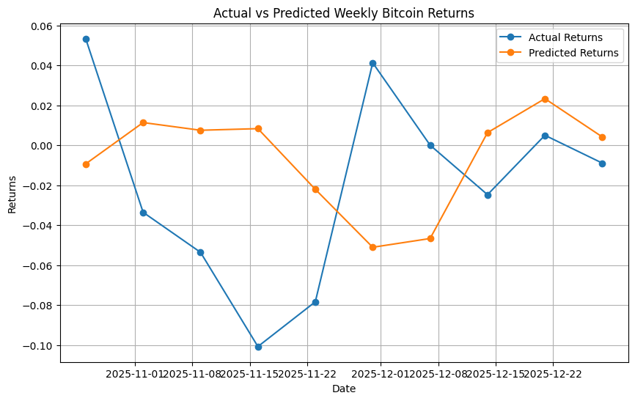
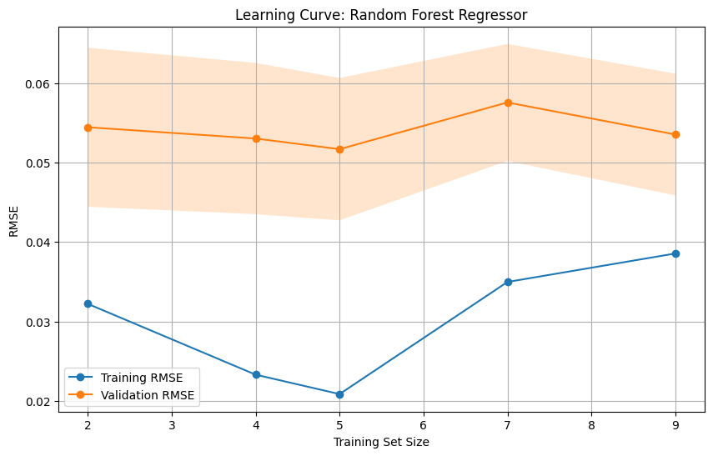
Machine learning: return prediction does not generalise well
Random Forest
Random Forest Regressor results
0.032
0.594
-0.847
Train RMSE
Test RMSE
Test R²
Lagged Trend_Bitcoin was the dominant feature in the model.
The model fitted the training data but missed large late-year return swings.
Negative out-of-sample R² means the model underperformed a simple benchmark.
Google Trends alone is not reliable for forecasting return direction.
Actual vs predicted returns
Decision: use Google Trends as a supplementary attention signal, not a standalone return-forecasting model.
Learning curve: validation error remains high
EDAB 6808 : Assignment 1
9/12
Notes:
Explain the predictive model honestly. The Random Forest gave poor test performance for returns, so it should not be oversold. Google Trends may be statistically related, but not strong enough for reliable return prediction.

Slide 10
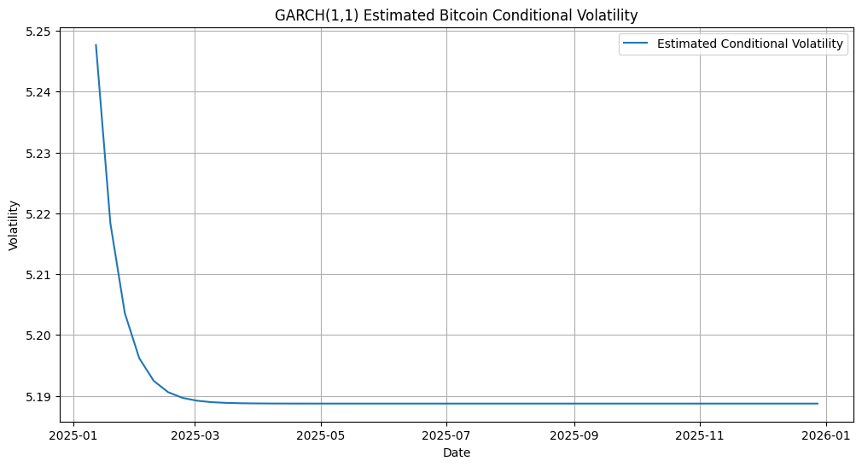
Volatility modelling: attention has limited incremental value
GARCH & volatility
Component
Result
Interpretation
μ
p = 0.763
Mean return not significant
α₁
≈ 0; p = 1.000
no shock effect
β₁
0.501; p = 0.419
weak but insignificant persistence
GARCH(1,1) conditional volatility
α + β
≈ 0.50
low volatility clustering
Volatility is weakly structured and largely stochastic in this sample.
Attention → volatility regression
0.035
0.288
Other attention variables were not significant in the combined model; individual attention-to-volatility models had very low R² values (≈0.003–0.043).
Lag 1 Trend_Bitcoin p-value
Model R²
Attention has limited explanatory power for volatility and does not significantly improve prediction.
EDAB 6808 : Assignment 1
10/12
Notes:
Explain that GARCH captured volatility but showed weak clustering in this sample. Trend_Bitcoin had one significant lag in the combined attention-to-volatility regression, but overall explanatory power was limited.

Slide 11
Hypothesis testing summary and recommendations
Synthesis
Area
Finding
Interpretation
Recommendations
H₀₁
(Lead–lag)
Partially rejected
Strong evidence that attention leads volume (~2 weeks), weaker for returns
Use Google Trends as a supplementary market-attention indicator.
Give more weight to volume and activity signals than to return direction.
Combine search attention with news, macro, liquidity and sentiment measures.
Extend the sample beyond one year to test robustness across Bitcoin cycles.
H₀₂
(Granger causality)
Partially rejected
Attention significantly predicts volume; weak short-term signal for returns
H₀₃
(Machine learning predictive power)
Fail, to reject
Random Forest fails out-of-sample (Test R² = -0.85)
H₀₄
(Volatility explanation)
Fail, to reject
GARCH shows weak volatility structure; attention adds limited value
Attention predicts market participation (volume),
but does not reliably predict price direction or volatility.
internet attention predicts when people enter the market, not how the market moves.
EDAB 6808 : Assignment 1
11/12
Notes:
Use this slide to synthesize everything. The report's key contribution is not one p-value; it is the integrated interpretation that attention is most useful for market participation, especially volume.

Slide 12
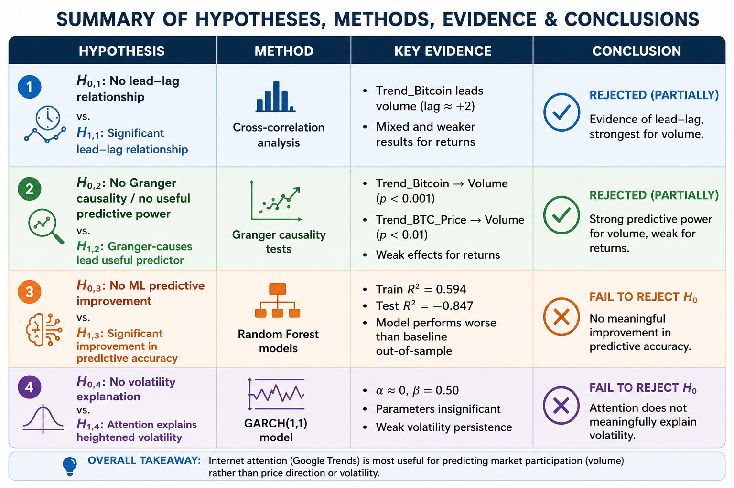
Conclusion
Thank you
Partial support for the role of internet attention in Bitcoin markets.
Final judgement
Google Trends offers useful behavioural insight into Bitcoin market attention.
The strongest evidence supports attention leading trading volume.
Return prediction remains weak and unstable out of sample.
Volatility evidence is limited and should be interpreted cautiously.
Search attention patterns
Therefore, Google Trends should be treated as a complementary market-attention signal, not as a standalone Bitcoin trading model.
Notes:
Close decisively. The strongest defensible conclusion is that Google Trends matters more for explaining participation and intensity than for predicting returns or volatility.

